Slide 1
Mixing Time – General Chains
Seminar on Random Walks on Graphs
2009/2010
Ilan Ben Bassat Omri Weinstein

Slide 2
Mixing Time - Lazy Chains
Given that:
Then:

Slide 3
Proof Sketch
Bound distance to stationary distribution by some function h:
Bound the value of ht(x) inductively.
Derive a bound on the mixing time.

Slide 4
Proof Sketch
Bound distance to stationary distribution by some function h:
Bound the value of ht(x) inductively.
Derive a bound on the mixing time.

Slide 5
Bounding Distributions Distance
For every

Slide 6
So, choosing for every S yields:
And for every vertex w we can get:

Slide 7
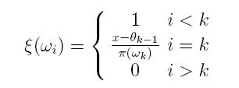
H(x) Values
Order the graph vertices:
And define . Find k such that:
Then the value of ht(x) is obtained by:
And we get:

Slide 8
Function H - Analysis
Piece-wise linear function.
Concave
Breakpoints at
On the interval [0,1]: and

Slide 9
Proof Sketch
Bound distance to stationary distribution by some function h:
Bound the value of ht(x) inductively.
Derive a bound on the mixing time.

Slide 10
Proof Sketch and Intuition
We will prove for every x and t:
Intuition: Bound the value h(x) in time t by going one step
backwards, and a bit towards the endpoints.
Prove will be in three parts:
For a finite group of discrete x values .
For all x values satisfying (and symmetric case).
For all x values and

Slide 11
Proof – Breakpoints
Fix k and let

Slide 12
Proof – cont’d

Slide 13
Proof – second case

Slide 14
Proof – Third Part
So, for every x we get:

Slide 15
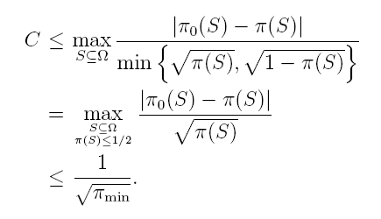
Base Case

Slide 16
Induction
For t=0 trivial.
For and

Slide 17
Induction

Slide 18
Proof Sketch
Bound distance to stationary distribution by some function h:
Bound the value of ht(x) inductively.
Derive a bound on the mixing time.

Slide 19
Mixing Time Proof
Given

